Slide 1
HISTORY OF SCHOOL SHOOTING
Laura Denfeld

Slide 2
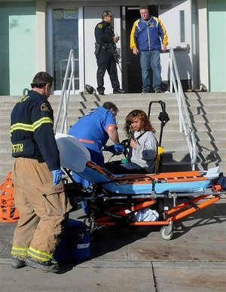
Calif. school shooting teen charged as adult
BAKERSFIELD, Calif. (AP) - A 16-year-old boy accused of shooting a classmate at a California high school has been charged as an adult. The Kern County district attorney's office announced on Monday that Bryan Oliver has been charged with attempted murder and other counts in the shooting on Thursday at Taft Union High School. A 16-year-old boy was wounded in the shooting. People in the small San Joaquin Valley town who know the suspect have said he was teased for his small stature. They describe him as smart but say he sometimes said irreverent things that brought scorn from classmates.

Slide 3
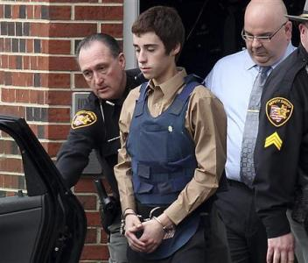
Prosecutors identified the shooter as T.J. Lane and said he has admitted to taking a knife and a .22-caliber pistol into the cafeteria at Chardon High School in a town 35 miles east of Cleveland on Monday and firing 10 rounds.
Students Demetrius Hewlin and Russell King Jr., 17, were both declared dead on Tuesday from wounds suffered in the incident, according to the Cuyahoga County Medical Examiner's office. Another student, Daniel Parmertor, 16, died on Monday.
Prosecutors told a judge in Geauga County Juvenile Court that Lane told them he had selected his victims randomly. In his court appearance, Lane was ordered held in detention pending the filing of formal charges. The judge gave prosecutors until Thursday to file charges.
One student remained hospitalized with wounds from the attack while another was released from a hospital as the town prepared to hold a vigil to honor the victims later on Tuesday. At the high school, students spent the day huddling, talking and placing red ribbons around the grounds.
The incident marked the latest shooting at a U.S. school. The deadliest school shooting in the United States was a 2007 massacre at Virginia Tech University that left 33 people dead. The deadliest high school shooting claimed 12 students and a teacher in 1999 at Columbine High School in Colorado.

Slide 4
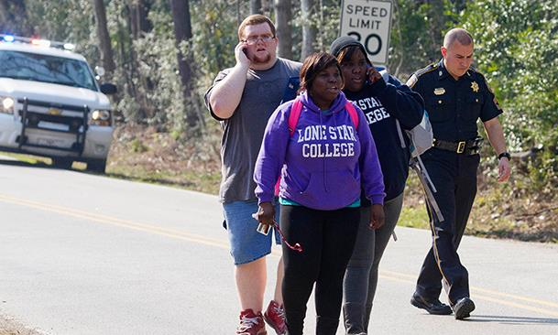
An argument between two people erupted in gunfire Tuesday at a Texas college near Houston that left them and a third person wounded, authorities said.
The shooting happened early Tuesday afternoon between the Academic Building and the library on the campus of Lone Star College-North Harris, north of Houston.
Authorities said two people got into an altercation and at least one of them pulled put a gun and opened fire. Those two were wounded, and a maintenance man described as an innocent bystander was also shot, said Maj. Armando Tello of the Harris County Sheriff’s Office.
One of the men involved in the argument was taken into custody at the scene and transported to a hospital, as was the maintenance man. The other wounded man turned himself in later at a hospital

Slide 5
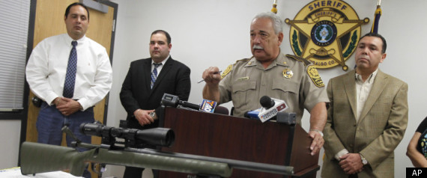
EDINBURG, Texas -- Doctors have removed a bullet from the back of a 13-year-old Texas boy shot while trying out for his middle school basketball team in December.
Tijerina and Edson Amaro were shot Dec. 12 outside Harwell Middle School. On Jan. 6, authorities charged Dustin Wesley Cook with aggravated assault for shooting 14-year-old Amaro, who lost a kidney. Cook was target shooting with a sniper rifle on ranchland nearly a mile away, but in line with the school.
Sheriff Lupe Trevino has indicated that if a bullet was recovered from Tijerina investigators would seek a ballistic match and charges.

Slide 6
BROWNSVILLE, Texas -- The Rev. Jorge Gomez was counseling worried parents and frightened students late into the night the day police fatally shot an eighth-grader brandishing what appeared to be a handgun inside his South Texas school. The parents said their children weren't eating, some were running fevers, and needed to talk to someone.
The death of 15-year-old Jaime Gonzalez has shaken this neighborhood along the U.S.-Mexico border, where parents already burdened by economic woes and street gangs are now faced with explaining the tragedy to their children.
Making it especially hard: It remains unclear to his parents and investigators why Jaime - a drum major who danced in his church's annual religious festival, stayed out of gangs and had two parents who closely watched him - could swerve off course and bring a weapon to school. The weapon, police later determined, was a pellet gun.

Slide 7
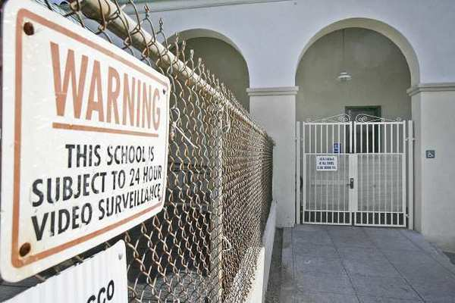
The shooting deaths of 20 first-graders at an elementary school in Newtown, Conn. has prompted Burbank Unified officials to install a buzz-in security system at Emerson Elementary School — the last campus of its kind to not have one.
Emerson — one of 11 elementary schools in the district — will also get an intercom and security camera as part of the security upgrade after Burbank Unified school board members approved the $9,000 project.
After the events at Sandy Hook Elementary in Newtown, in which a shooter shot and killed 26 people, including 20 students — officials reviewed existing security measures at Burbank’s elementary school campuses.

